Slide 1
Project Management Atlantis Project
Thomas DROUIN, Mathieu JUBENOT, Victor SCHIRMANN, Simon TODESCHINI

Slide 2
Summary
Work Breakdown Structure
Project Management Method Explained
Scrum Methodology
Team Roles
Daily Meetings
Lifecycle
Estimating Work
Burndown ChartSprint Retrospective
Development process
Collaborative Tools
Continuous Integration tools

Slide 3
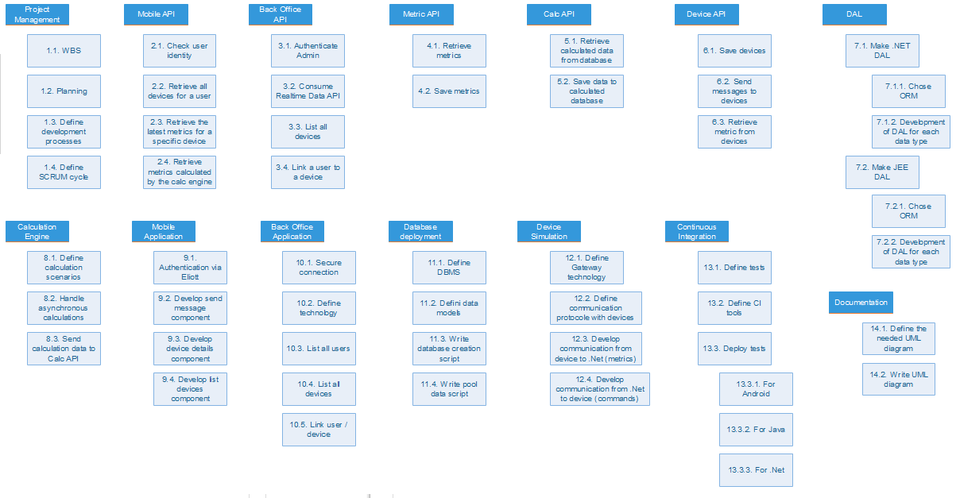
Work Breakdown Structure

Slide 4
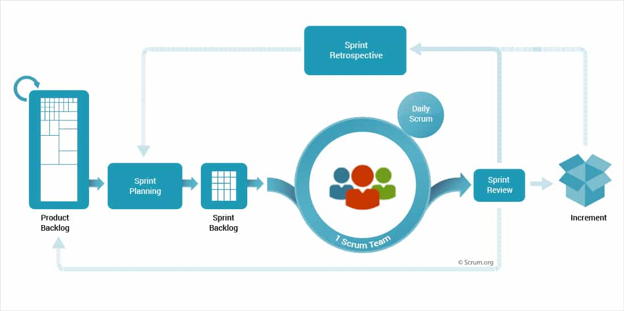
Project Management Method Scrum Methodology
We will handle this project using Scrum, a focused yet flexible project management strategy that consists in working through an iterative software development process.

Slide 5
Project Management Method Time Organization
Unlike the average scrum method implementations, we decided to make 2,5-days sprints because of the relatively short time which is given to us for this project. Except this, we will handle Scrum in a very classic way that will be explained on the next panels.
Project starts (21/06)
Launching phase (21/06 => 24/06)
Sprint 1 (25/06 => 27/06)
Sprint 2 (27/06 => 29/06)
Sprint 3 (02/07 => 03/07)
Project ends (03/07)

Slide 6
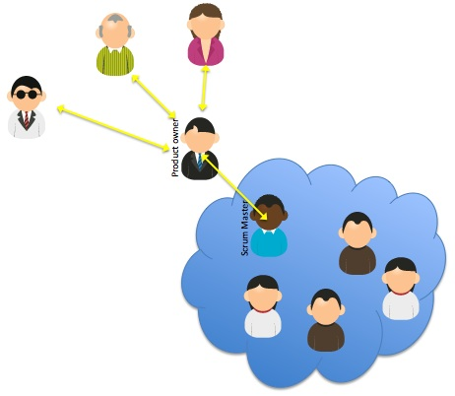
Project Management Method Team Roles
Product Owner : Is responsible for what goes into the product backlog and priotizes it.
Scrum Master : Ensure that all the team members have what they need to get the job done. He also chairs the scrum meetings.
Developers & Testers : They write the code following the development lifecycle. They are also actors of the scrum methodology as they are encouraged to give advices or ideas during sprint retrospective meetings.

Slide 7

Project Management Method Daily Scrum Meetings
A Daily Scrum Meeting will be done every morning in order to ensure everything is on track and everyone has the tools they need.
From these meetings will be written daily reports which contains for each developer :
What they have done on the previous day
What they are planning to do today
The problems they encountered (this will become the problems backlog)
These meetings are also intended to discuss about potential problems that could have been encountered by a developer during the previous day.

Slide 8
Project Management Method Lifecycle
For our project we will use the following kanban table in order to manage our tasks for each sprint.
Product Backlog : All the tasks of our project from the work breakdown structure.
Release Backlog : All the tasks we need to do for the actual sprint scope.
Work in Progress : One or several members are currently working on the task.
Review : The task need to be reviewed before validation. If something is missing or wrong, the task will go back to the work in progress column.
Done : The task has been validated and will be flushed into the Archive column once the next sprint start.

Slide 9

Project Management Method Estimating Work
Hours : When estimating work, we need to all use the same standard. Here we will use hours in order to estimate the time needed for each of our tasks.
Story Points : Story points are points given to a task in adequacy with his complexity. We could have used this unit for our project but we stated that giving estimation time was enough in this case.

Slide 10
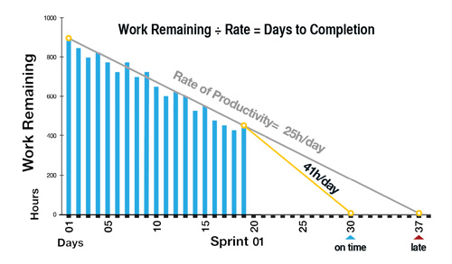
Project Management Method Burndown charts
The progress of the team will be tracked using a burndown chart for each sprint.
Once our tasks has been given an expected time of work, we will add up the remaining time needed on each task of our current sprint, in order to build a chart that help us track our progress.
The burndown velocity (Rate of Productivity), will be calculated by comparing the number of hours worked to the original project estimation and will show us the average rate of productivity for each day.

Slide 11

Project Management Method Sprint Retrospective Meetings
After each sprint, the team will setup a longer meeting in order to eventually refine the process.
This meeting will be chaired by the scrum master. The aim is to take the last sprint retrospective report and the problems backlog, and create an environment conducive to expression in order to find solutions.
We will come out of the meeting with potentially an action plan for the sprint that will start. Actions can be logged in the psinrt backlog.

Slide 12
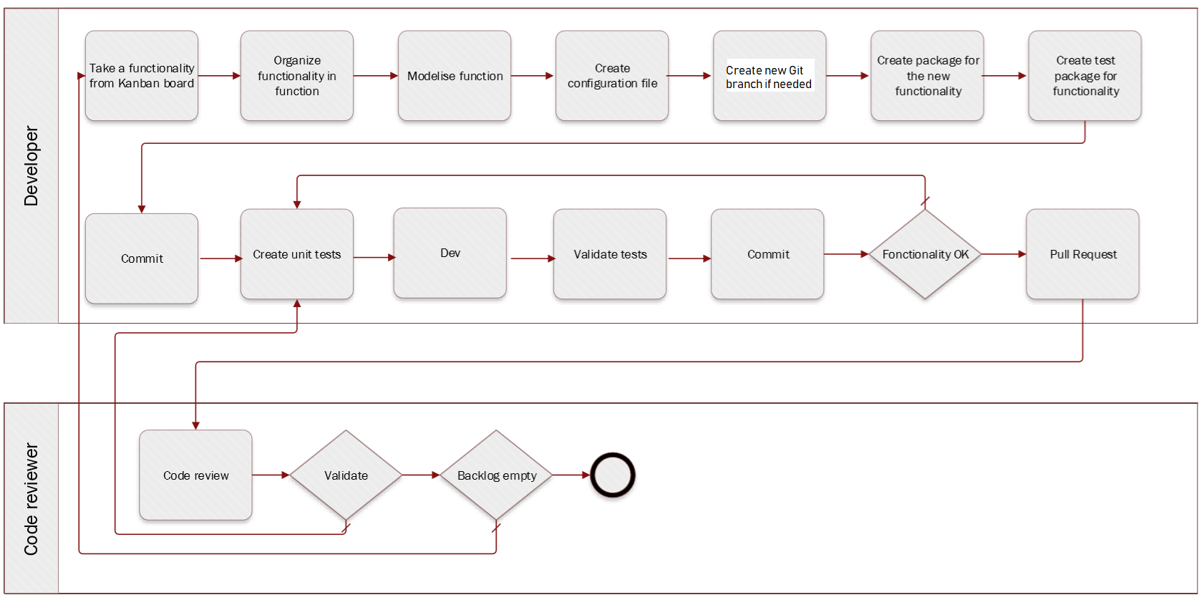
Project Management Method Development process
The following process has been defined to be used during development for each task :

Slide 13



Collaborative tools
Github will be used for our versionning. Each push has to be validated by doing a pull request. The team members will then look at the pull request and comment it. If everyone find its content is correct, then the pull request is accepted.
Slack will be used in order to handle team discussions and having a way to contact members of the team at any time.
Our kanban table will be made using Trello. All members will have access to it and we will be able to handle our tasks using this very useful tool.

Slide 14





Description of the continuous integration tools
Travis CI is a hosted, distributed continuous integration service used to build and test software projects hosted at GitHub. We will use this tool for our whole project.
For our JEE part, we will use Maven as a build automation tool, as well as JUnit.
NUnit is an open-source unit testing framework that we will use for Microsoft .NET. It serves the same purpose as Junit does in the Java world.
Jasmine is an open source testing framework for JavaScript. We will use it for doing our Android tests, as well as Karma for running our tests.

